Slide 1
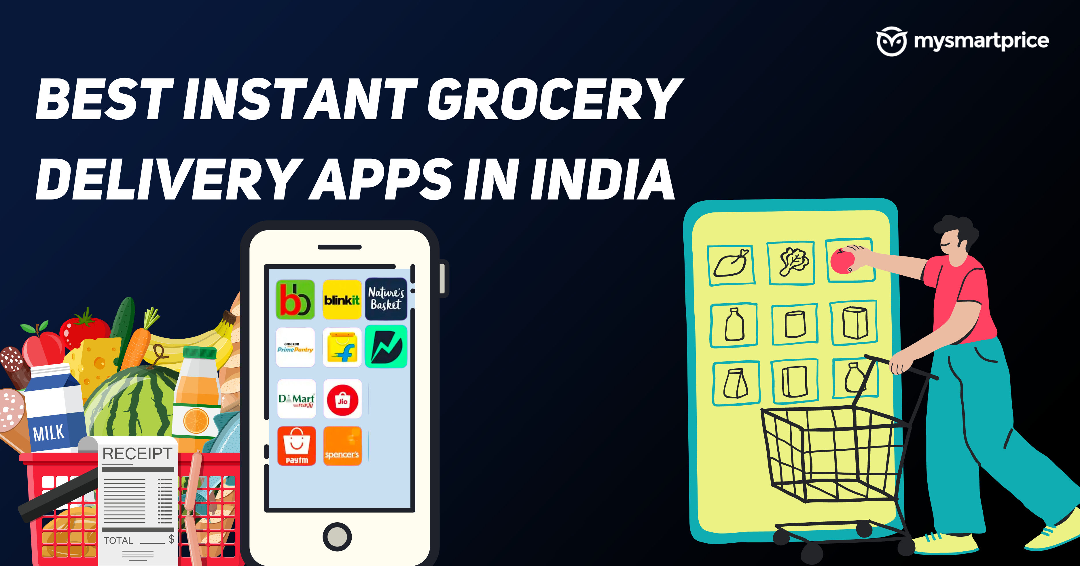
G
R
O
C
E
R
Y

Slide 2
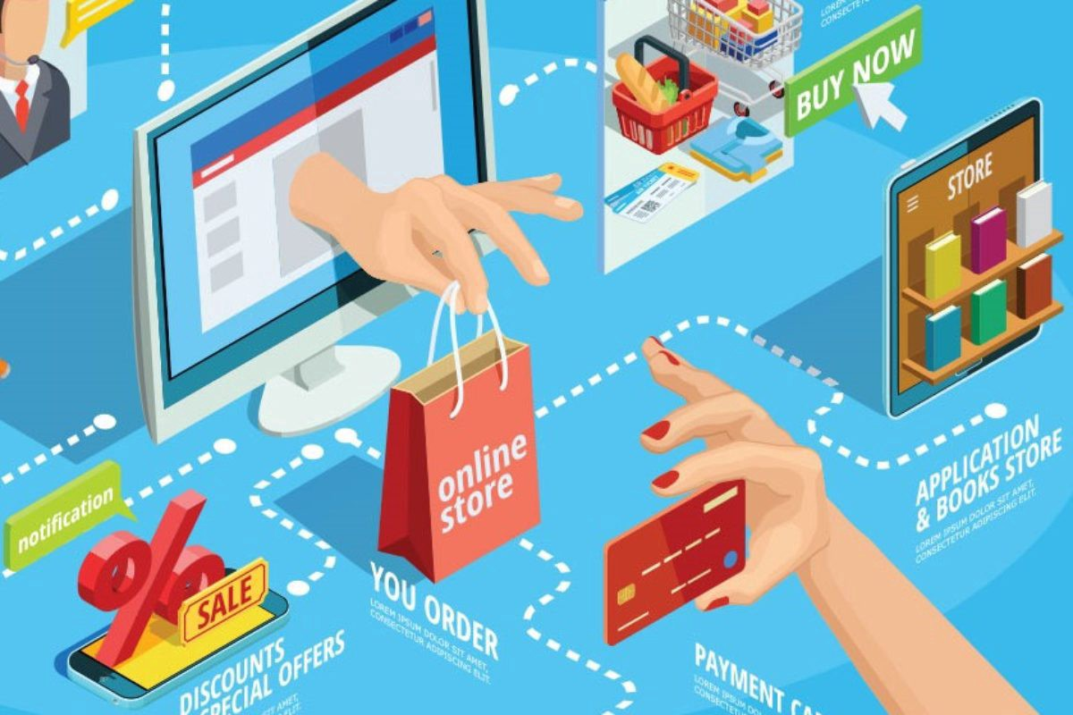
EMERGENCE OF THE CONCEPT OF E-GROCERY
This business model started in the late 90s and early 20s. Some of the earliest have been mentioned below:-
British company introduced the first online grocery delivery called TESCO in 1996. And after that, Ocado started in 2002 with the same business model.
Later in the US this business was started by Peapod in 1996 and Fresh Direct in 2002.

Slide 3
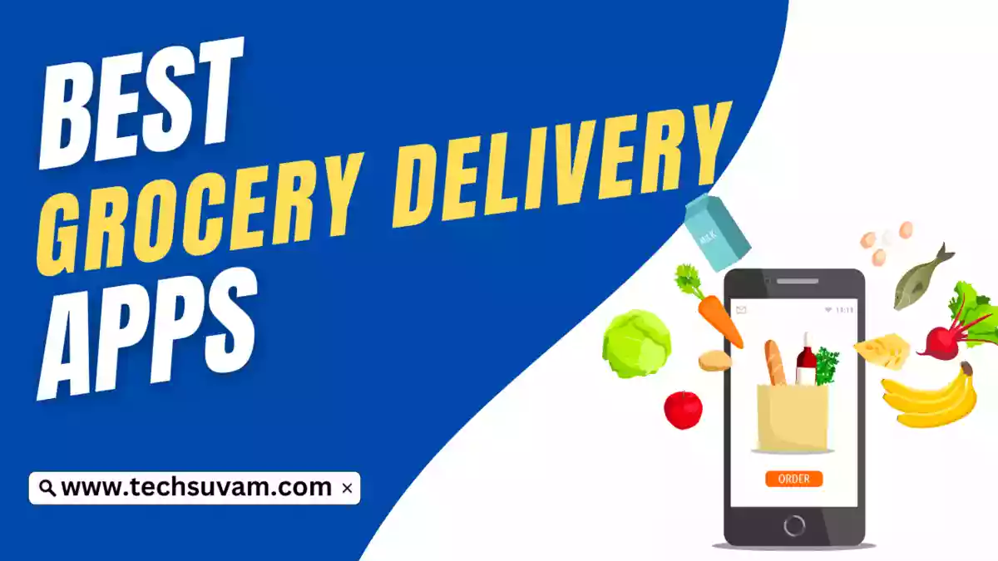
INDIAN E-COMMERCE MARKET
Evolution of Indian E-Commerce Industry
2005
2011
2013
2016
2018
2020
Natures Basket
Grofers
Flipkart Grocery
Big Basket
Amazon Pantry
Jio Mart
The market value of online groceries across India was over 669 billion Indian rupees in 2023.
Study shows that in 2021 around 40 E-Commerce companies shut their business due to various economic and other challenges.

Slide 4



MARKET SHARE OF E-GROCERY APPS IN INDIA (DEC 2021)

Slide 5
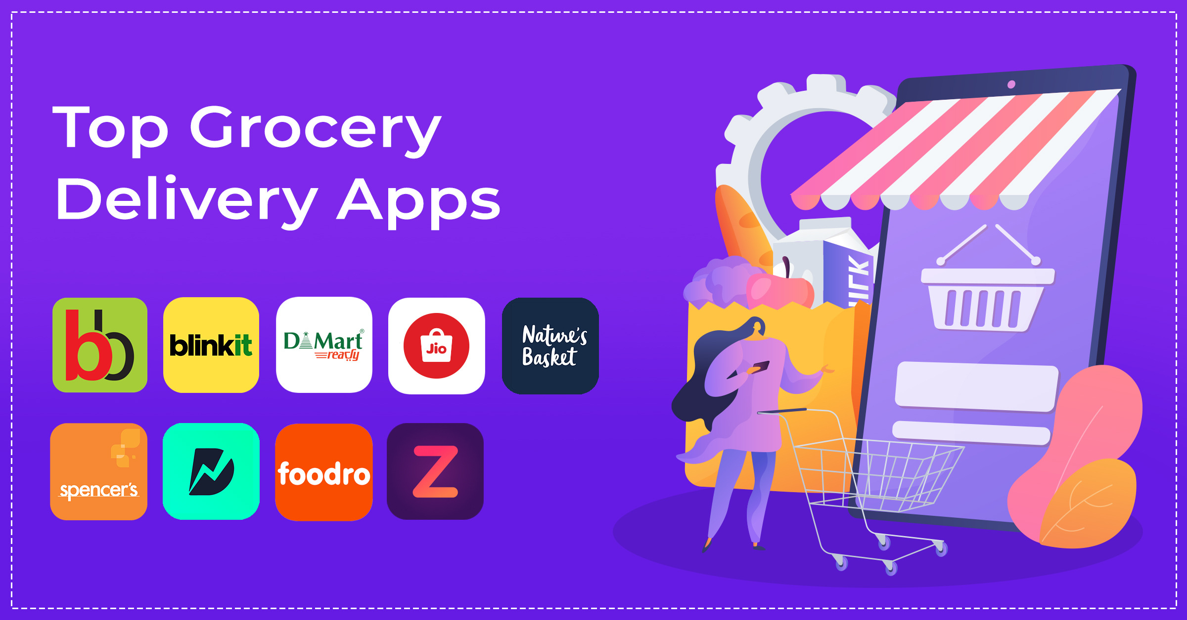
JIO MART
Integration with WhatsApp and the local markets.
Competitive pricing with wholesale rate.
FLIPKART GROCERY
Competitive pricing and its integration with the larger Flipkart Ecosystem.
One-day delivery with cash on delivery option available.
POSTMATES
grocery delivery with food deliveries.
Alcohol delivery.
On-demand delivery even outside traditional delivery hours.
AMAZON PANTRY
Free and fast delivery, prime member subscription
Subscription services which automatically order the frequently purchase item as per previous order.
Use of alexa.
USP OF SOME BIG E-GROCERY APPS
BIG BASKET
Focus on freshness and include fresh products, gourmet products, and some international brands.
Flexibility in delivery as 1-hour slots are available.
SHIPT
Membership benefits.
Network of personal shoppers create sense of personalize touch.
BLINKIT
Convenience and faster delivery.
Local grocery store collaboration
Personalized experience.
INSTACART
Collaboration with big chains as well as local favourites.
Same-day delivery.

Slide 6
ANALYSIS OF TOP COMPANIES IN INDIA AND THEIR EXPENDITURE
COMPANIES | SUCCESSFUL | ISSUES
Big Basket | Provides fast and reliable delivery options | -
Amazon Fresh | Offers a vast selection of groceries. | Only essential commodities are delivered on the same day and high overhead costs.
Jio Mart | Available in most of the cities with many outlets. | The interface is not user-friendly.
Flipkart Grocery | Offers competitive pricing and discounts | Managing perishable items and high overhead costs.
Blinkit | They focus on selected top-quality items | Less Variety Available
Zepto | Focuses on ultra-fast delivery, promising delivery within minutes of placing an order. | Offering a limited selection of products.
Expenditure per 100 rupees

Slide 7


Flipkart grocery – challenges from big market competitors.
PepperTap – high customer acquisition cost and competition.
Aaramshop – operational non effectiveness
ZopNow –latefunding and operational issues r acquired by a large chain.
SUCCESSFUL
E-GROCERY PLATFORMS
Big basket – a wide range of products including fresh and dairy products.
Amazon pantry – large user base, complimentary with Prime subscription
Reliance Jio Mart – big chain with a wholesale market
Instacart – a collaboration with big chains and effective operations
UNSUCCESSFUL
E-GROCERY PLATFORMS

Slide 8
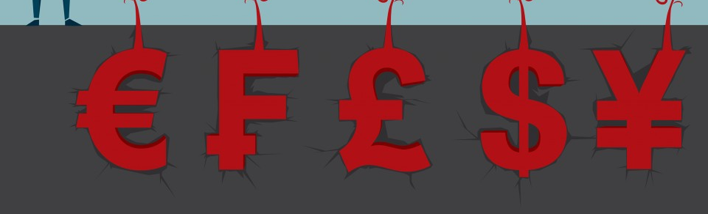
ALSO, WHY BIG PLAYERS ENTER INTO THIS DOMAIN?
Even in the very competitive market big players still enter because of GenZ generation and increasing demands.
Increase in nuclear families in Tier 1 and 2 cities.
Time constraints due to hectic working conditions.

Slide 9

OUR COMPANY

Slide 10
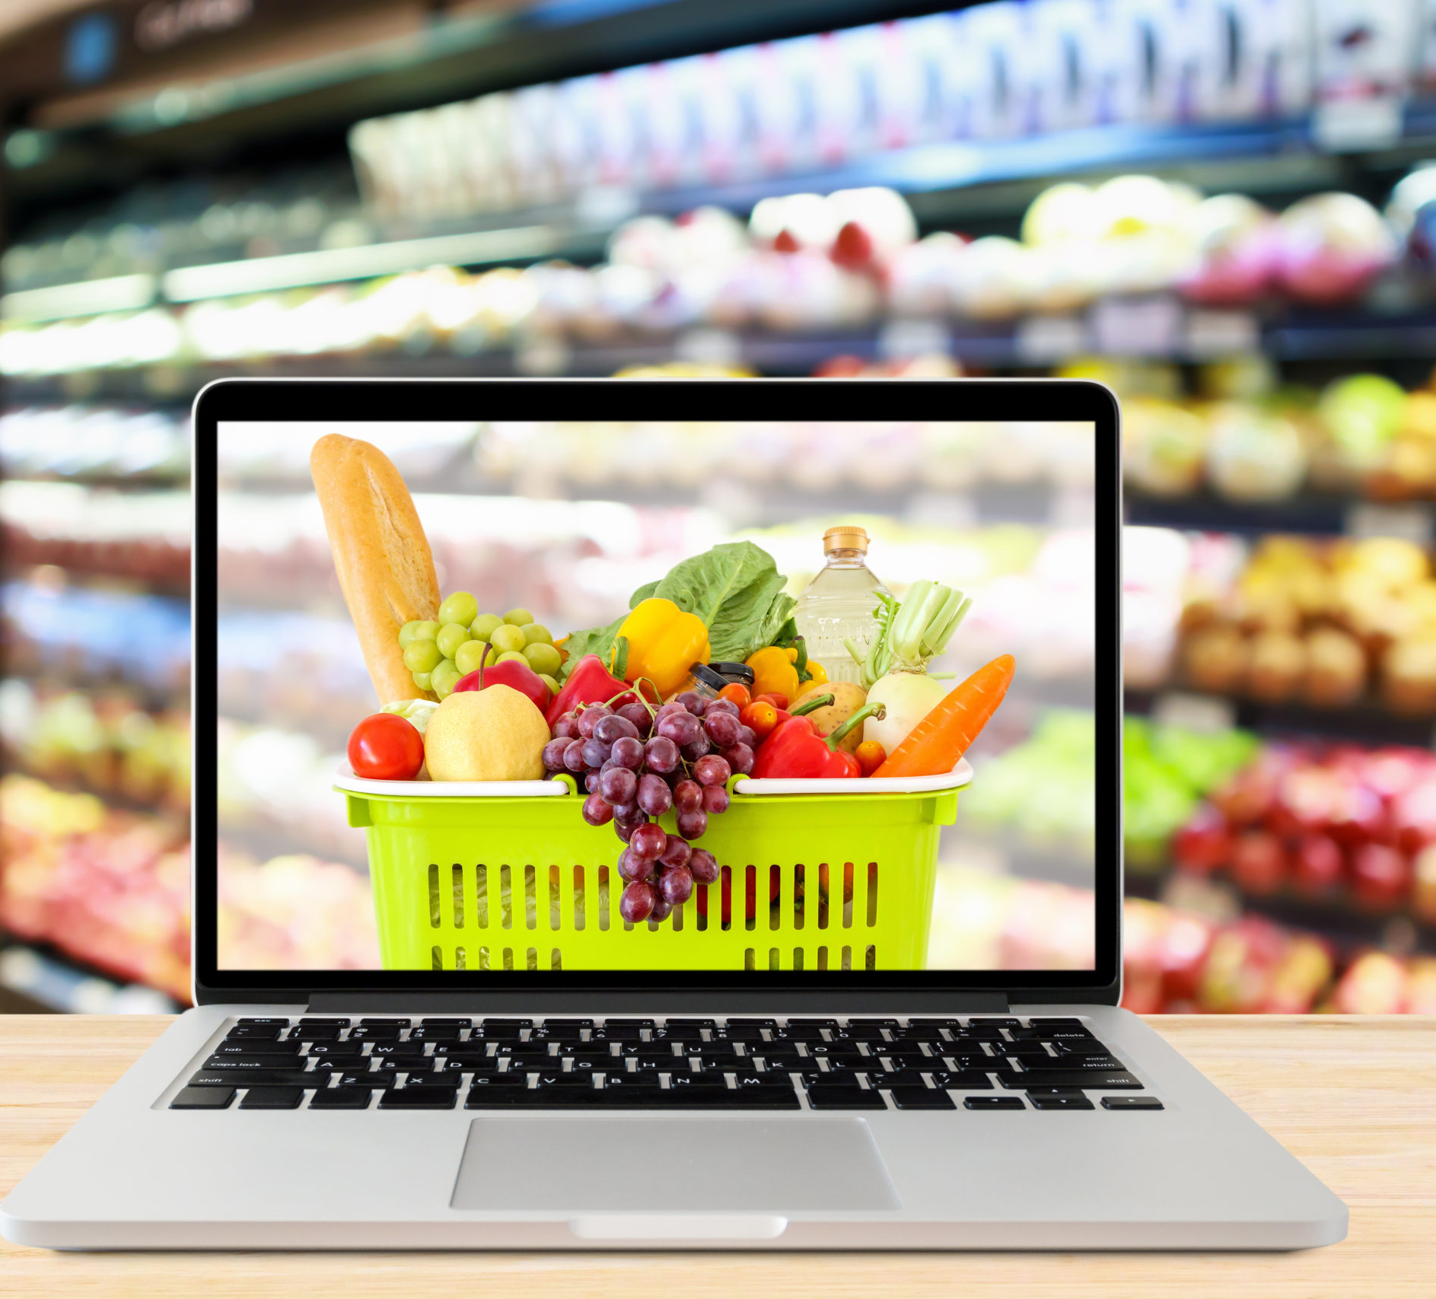
ABOUT US
Bharat Basket is India's premier e-grocery platform, offering a wide range of quality products sourced from local farmers and trusted vendors. With a focus on convenience and affordability, we aim to revolutionize the online grocery shopping experience.

Slide 11

PROBLEMS IN E-COMMERCE MARKET
Friendly Relations – Kirana shops maintain good relations and places for local chitchat. It also provides commodities on credit.
Order Value – The value per order is less
let’s say around 400 INR and the company earns 10 % of the order value before making other expenditures. Sometimes their expenditure is more than their earning.
Delivery Boy Turnover
Indian Mindset – Always look for discount
Marketing Cost
Around 20% of Blinkit’s revenue is used in advertisement and marketing
Margin on products - It is a low-margin business, with thin profit margins due to high operational costs.
Market saturation due to numerous players.

Slide 12

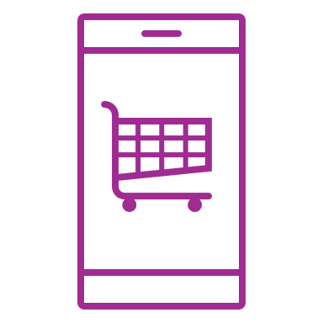



SOLUTION
Close the gap
Target audience
Cost savings
Easy to use
Our product makes online shopping more available to small business owners, and no other product on the market offers the same benefits.
Gen Z (18-25 years old) as well as older generation.
Reduce expenses, Subscription-based,
A simple product that gives customers the information they need to order online and ship to their location within time.
12

Slide 13
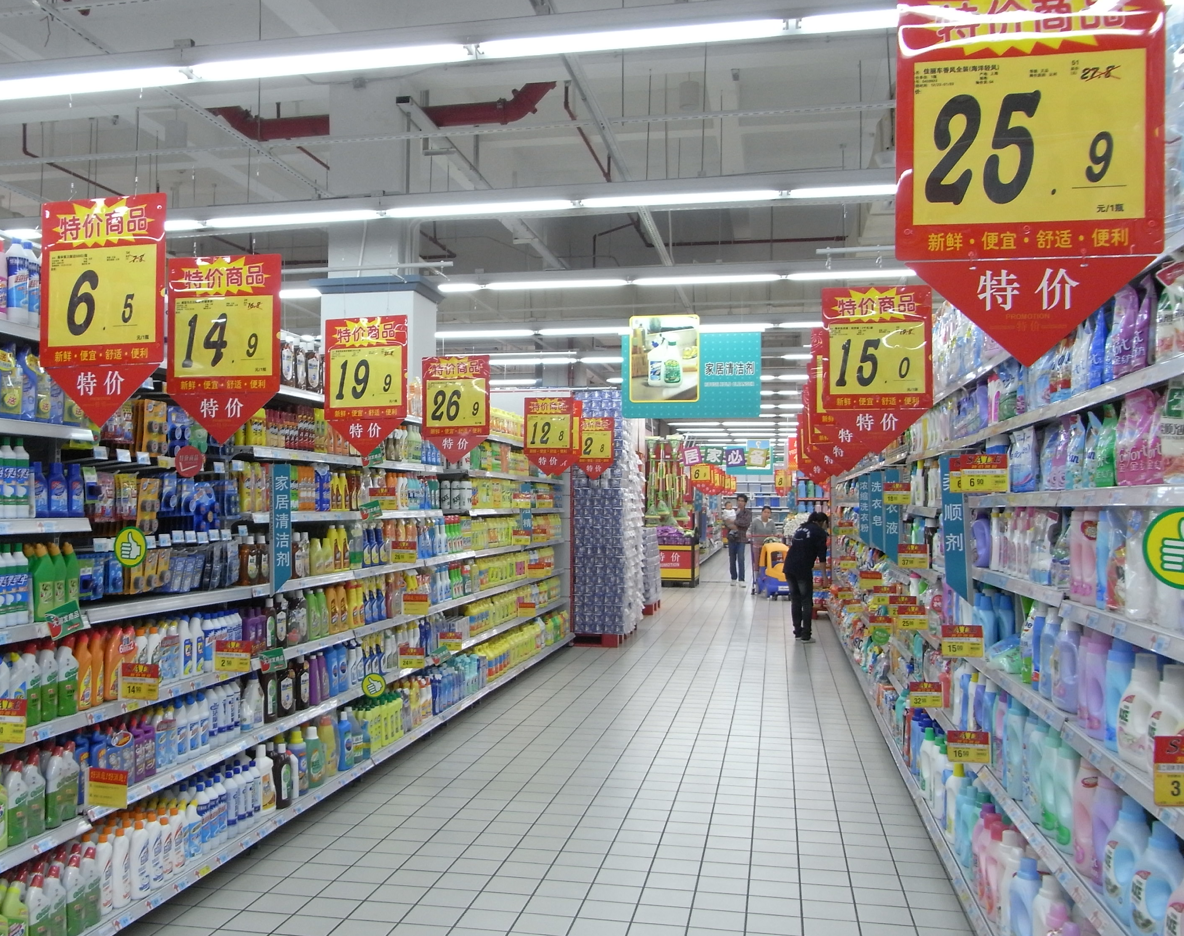
PRODUCT BENEFITS
Simple and easy to use.
User-friendly interface
Target both branded and local tastes.
Fast delivery with additional benefits in terms of points.
Chat with the store for alternate or fitness-friendly options

Slide 14
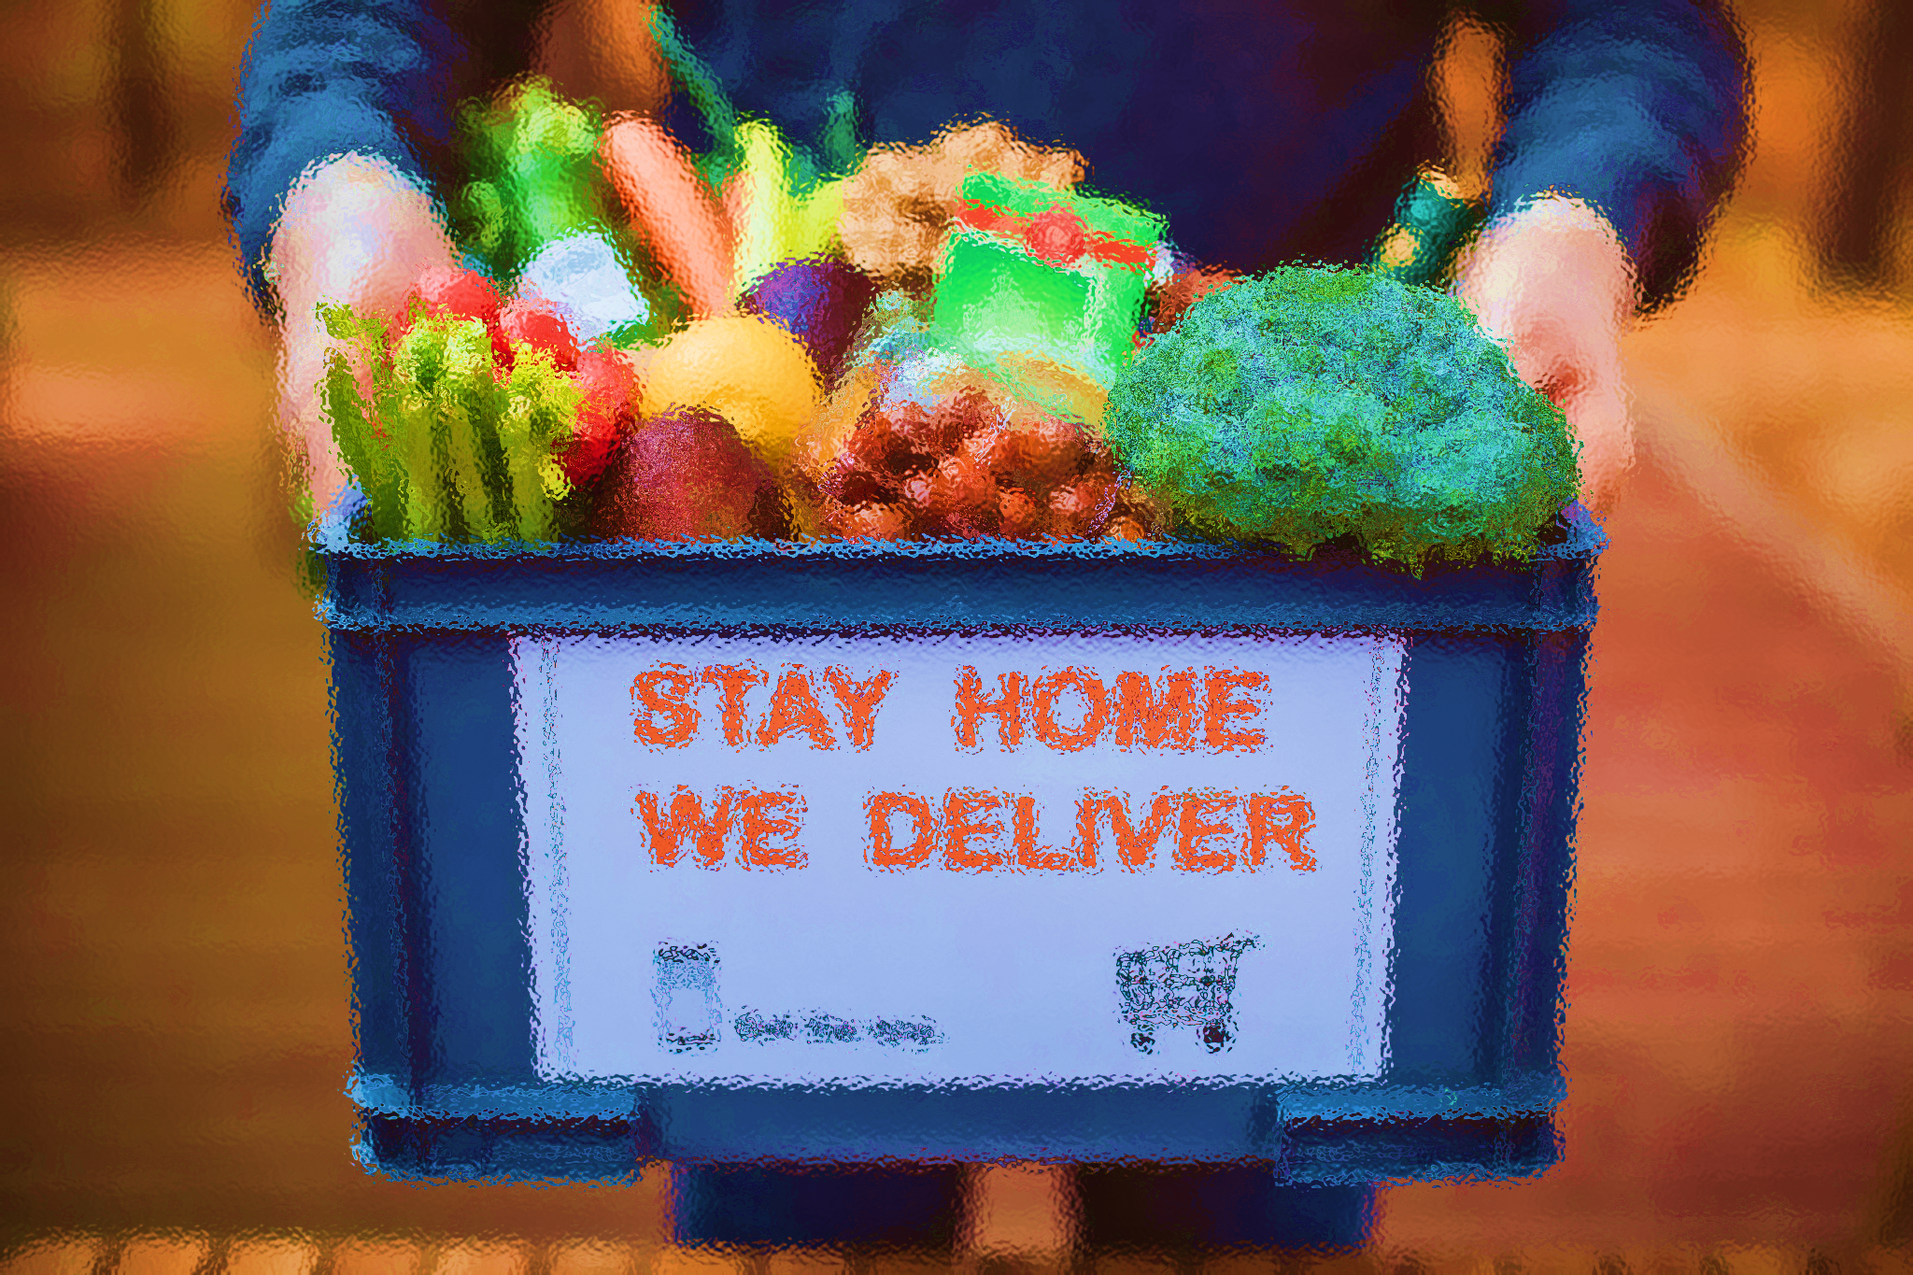



BUSINESS MODEL
Research
Abstract
Design
We based our research on market trends and social media trends
We believe people need better tools for online shopping that cater to small business owners
Minimalist design and easy to use

Slide 15


Covers a radius of 5-6 km, has a lot of inventory, and serves as take takeaway point for the riders. Only for online purchases.
Dark Store
D
Users
HOW ONLINE GROCERY WORKS
A
B
E
C

Slide 16
SEED FUNDING
1. Angel Investment
-Amount obtained through other investors
2. Campaigns
Revenue obtained from online campaigns
3. Cash
Liquid cash we have on hand
4. Others
Total = 90 Lakhs

Slide 17

GROWTH STRATEGY
How we’ll scale in the future 2025
January
February
March
April
May
June
Based on the past 12 months’ market research make conclusions and make ready to launch the product
Develop a user-friendly interface and launch the app on various app stores for users.
Build relations and collaborations with more local stores.
July
August
September
October
November
December
Gather feedback from the retail community and customers to expand the availability and reach of the product

Slide 18




R
I
G
H
T
S
C
Y
B
E
R

Slide 19

CYBER RIGHTS E-Grocery USERS
SOCIAL RIGHTS
Freedom of association –
Reviews and comparisons available for choices.
Right to expression –
to post the honest reviews without manipulating or censor.
TECHNOLOGICAL RIGHTS
Security and privacy –
key aspects in data transfer and storage.
Accessibility –
made in such as way so to reduce discrimination and provide alternatives to persons lacking technical skills.
COMMERCIAL RIGHTS
Fair competition –
to adhere to the health competition and pricing policy as per the Competition Act 2002.
Consumer protection –
in case of fraud or payment-related issues.
Intellectual property rights

Slide 20

DUAL ROLE OF TECHNOLOGY
Enhancing cyber rights
1. Encryption of data, protect the sensitive information.
2. Biometric authentication like fingerprint or face recognition enhances security.
3. Informed consent of users in terms of data collection, use, and sharing.
Threats to Cyber Rights
Surveillance tool to monitor the user behavior and pattern.
Algorithmic bias leads to discrimination between the users and recommending products based on pricing or ability.
Data breaches in terms of identity theft and financial loss.
Targeted advertising violates the right to privacy.

Slide 21

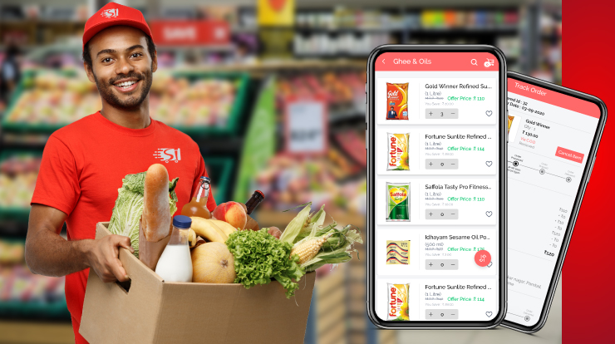
COMPANIES AND PRODUCT
- Enhancing Rights vs Exploiting Rights
Privacy-focused E-Grocery platforms – Our company give priority to user privacy and data protection by using strong encryption and its implementation.
Voice – Ordering – We have “voice ordering” feature improves accessibility.
Secure Payment Solution – Razorpay and Paytm emphasize protection against payment fraud and smooth financial transactions.
Ethical AI and Algorithmic Fairness – Google offers various frameworks for ethical AI, helping apps to mitigate biases.
Targeted advertising companies – We avoid selling data to third parties threatens user privacy and is used for targeted advertisement.

Slide 22
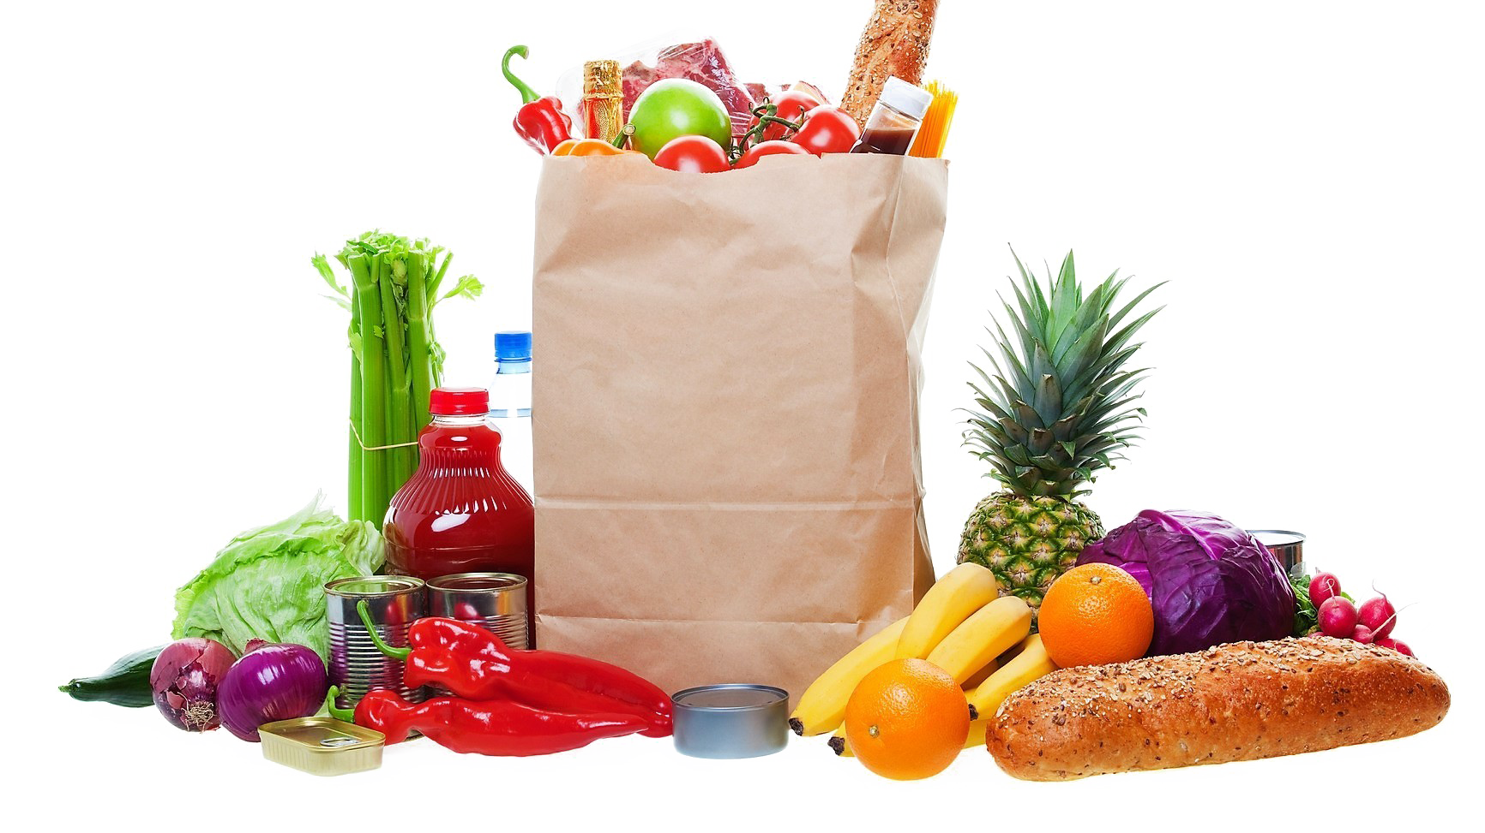
THANKYOU

